Slide 1
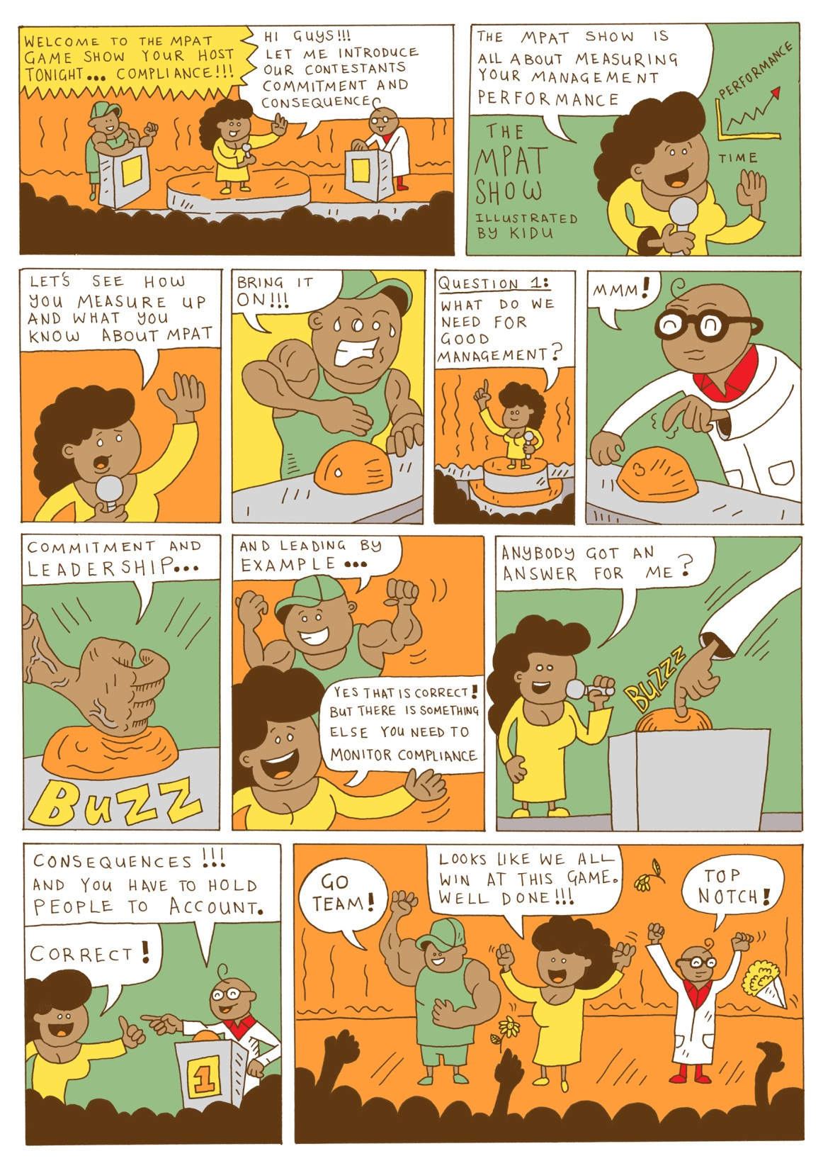
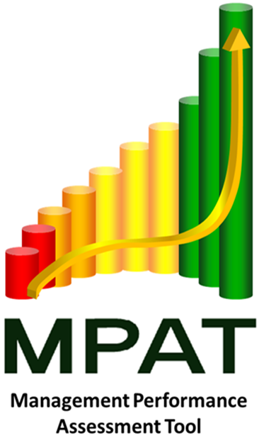
Improving your management practice
Learning workshop
LEADERSHIP
Commitment
CONTINUOUS IMPROVEMENT
RESULTS

Slide 2
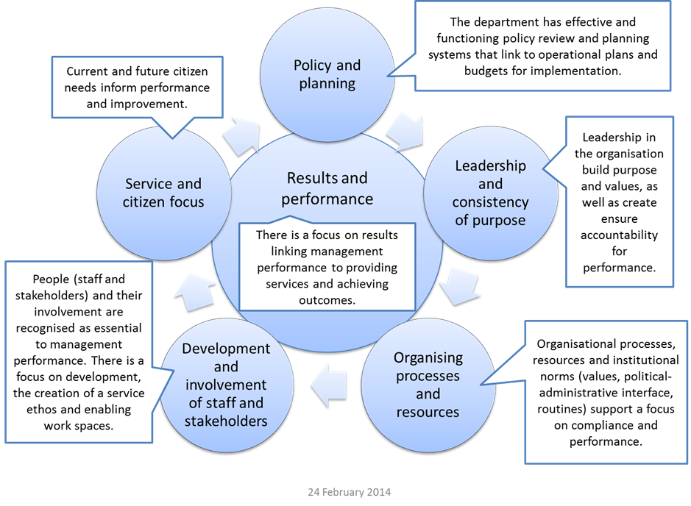
Learning from MPAT - analysis
Source: Mc Lennan, 2014

Slide 3
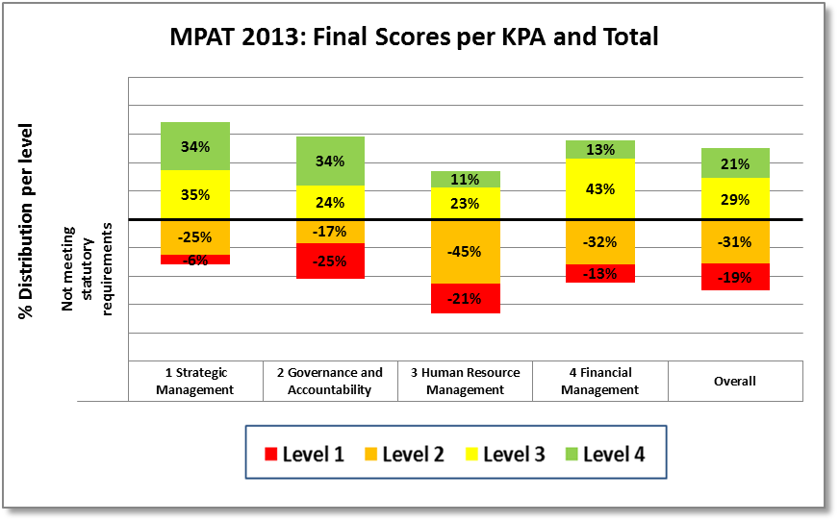
Learning from MPAT - results
70% of departments (79% in 2012) are still non-compliant with the standard for service delivery improvement
73% of departments are non-compliant with the standard related to the Promotion of Access to Information Act
65% of departments (74% in 2012) were assessed as non-compliant with the standard related to organisational design
82% of department (88% in 2012) were assessed as non-compliant for the standard related to human resource planning,
90% of departments (88% in 2012) were assessed as non-compliant for management of disciplinary cases.
87% of departments non-compliant on payment of suppliers.

Slide 4
Learning from MPAT - results

Slide 5
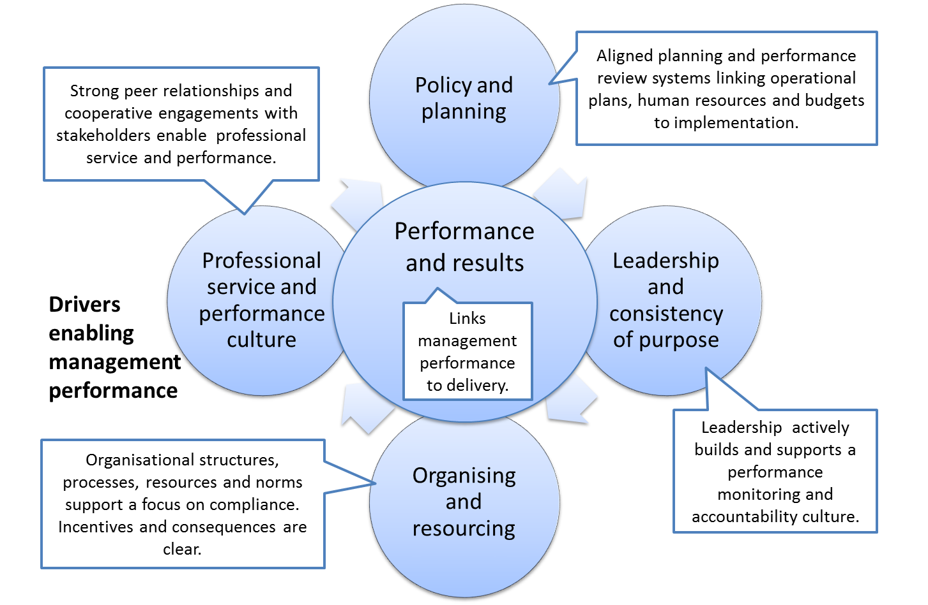
Learning from MPAT - drivers
Source: Mc Lennan, 2014

Slide 6
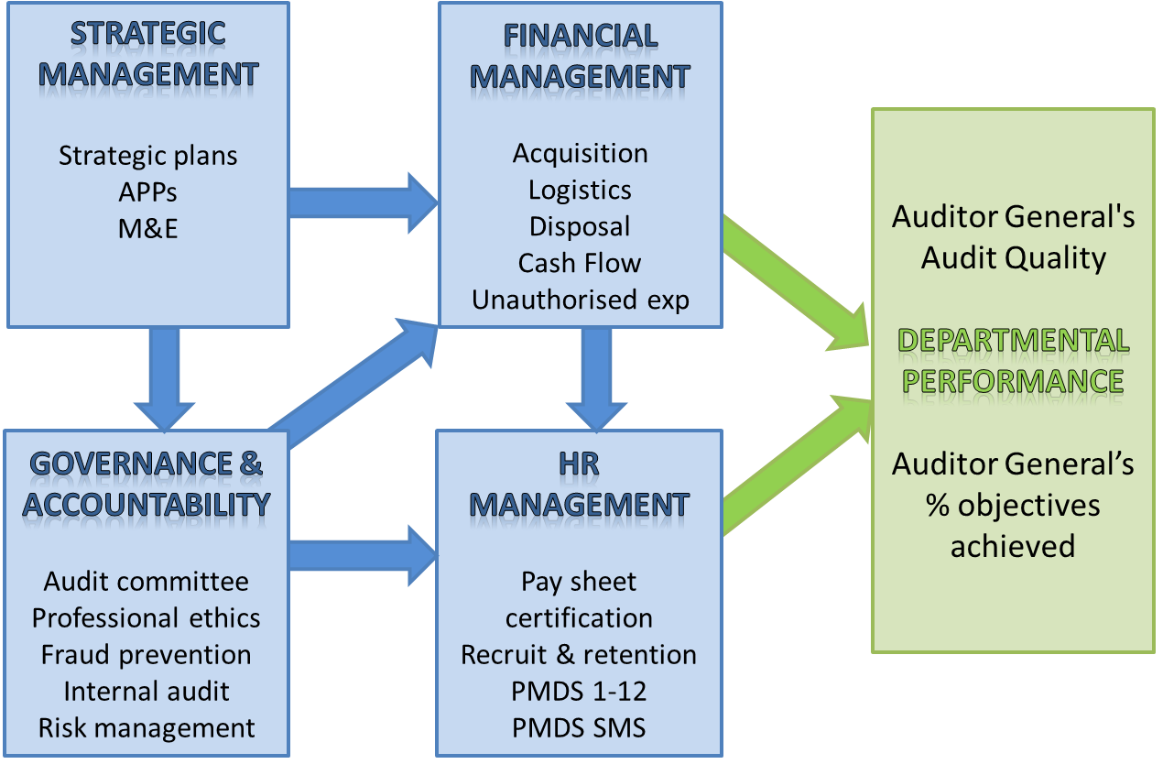
Learning from MPAT - drivers

Slide 7
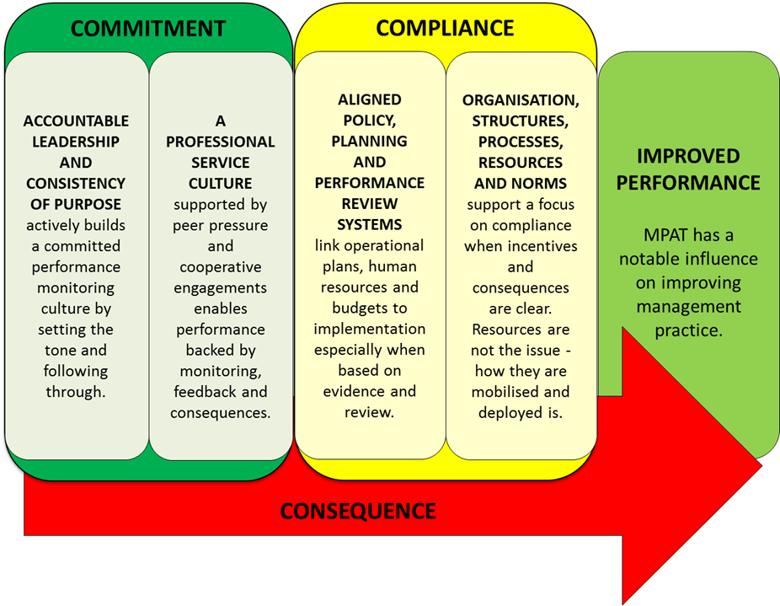
Learning from MPAT - practice
We still have a lot of work to be done to get staff to appreciate service delivery and to have a customer centric view.
An official from Department of Home Affairs

Slide 8
Drivers and conditions of improvement
DRIVERS
CONDITIONS
Accountable and consistent leadership which actively builds a committed performance monitoring culture by setting the tone and following through.
Policy and planning provides a foundation on which a department canon build to meet their objectives. In this regard planning often drives improved practice. Set targets and stick to them.
Compliance is a source of innovation. Using factual evidence and data in engagements with internal and external stakeholders drives change.
Needing to do more with less is a driver of innovation and improvement.
A professional and accountable service culture is a requirement for successful delivery. Smart departments hold people to account.
Effective and consistent monitoring for learning and action based on evidence is critical to sustaining improvement.
Target setting is an important part of aligning strategic and operational processes without conflating them.
The right people, with the right skills, using the right tools and systems are fundamental to service delivery.

Slide 9
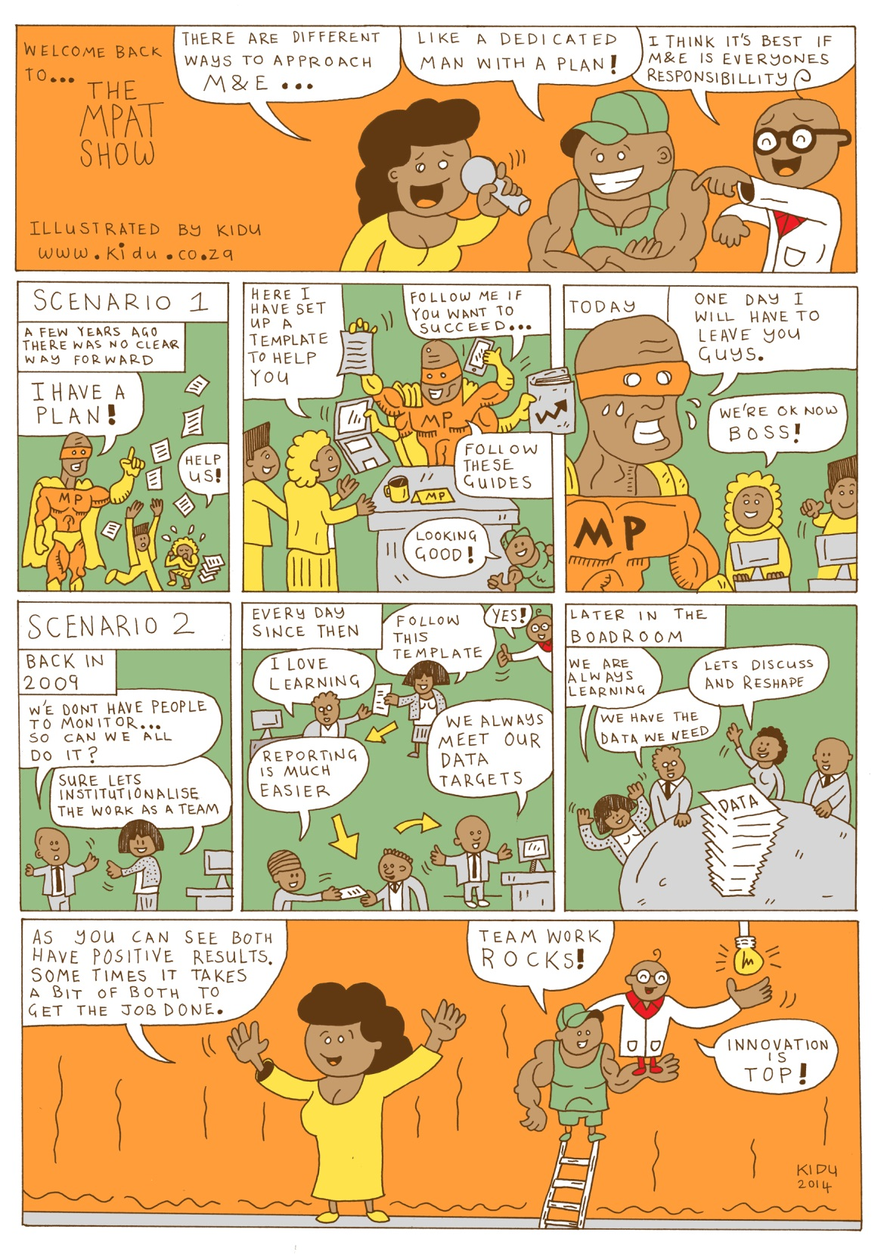
Lessons
Strategic Management
Hanlie Robertson

Slide 10
Management and organisational performance
Governmental outputs and outcomes depend on several, including environmental factors; client/ consumer/ citizen characteristics; treatments (policy, core processes and technologies); organisational structures, and MANAGEMENT – managerial roles, strategies or actions
O=f(E,C,T,S,M) (political economy approach)
Increasingly challenged by new diffused, horizontal ways of organising delivery - networks

Slide 11
Strategic management and the performance measurement
Strategic management drives policy implementation
Strategic and performance management systems and procedures in the public sector has become “international standard practice”
Outcomes-based government and evidence based decision-making (facilitated by resource pressures and changes in ICT)
NPM impulses (private vs public sector contexts)

Slide 12
Strategic management, administration/management and governance
Strategic Management encompasses a range of the generic functions - planning, directing, coordinating and reporting
Informs organisation, staffing and budgeting → providing the vehicle to integrate and align across functions
Strategic management overcomes shortcomings of generic functional approaches by linking the external environment with the internal operations.
From a systems perspective strategic management contextualises the organisation and what it does (can do).
Provides the basis to engage with the core concept of public administration, i.e. accountability as well as various goals of public sector action, i.e. efficiency, effectiveness and equity

Slide 13
Global reform influence re performance measurement in public domain
Commonwealth countries – this thinking very strong diffusion into Africa
OECD – World Bank
USA
In Search of Excellence (1982)
Reinventing Government (1992)
Score Card Movement by Kaplan and Norton
Public Values work by Mark Moore

Slide 14
Considerations and concerns
Political vs technical
Power shifts in institutional and organisational landscape
Use (non-use) of performance information
Inadequate resources and capacity for performance measurement activities → became an industry in itself
Complexity, multiple and conflicting goals; arms-length implementation arrangements
Government-wide approaches
Appropriate approaches for different settings

Slide 15
KPA1: Strategic Management
2 areas, assessed through 3 indicators only
AREAS | KPA INDICATORS
Strategic planning | Existence and quality of Strategic Plans Existence and quality of Annual Performance Plans
M&E | Integration of M&E into performance and strategic management

Slide 16
Strategic management
Processes and activities to systematically coordinate and align resources and actions with mission, vision and strategy throughout the organisation in response to environmental conditions
  More than the development of/ existence of a strategic plan
  Includes the implementation of the strategic plan (and its operationalized iterations, e.g. the APP) throughout the organisation, the measurement and evaluation of results, and the implementation of improvements based on M&E
  Uses information on contextual factors and the organisation’s performance to revise the strategy and inform annual performance plans.

Slide 17
Overall findings
Baseline for KPA 1: SM is highest of all (around 3)
  68% compliance rating
Compared with 2012 saw a slight decline in SM scores in 2013 (standards for level 3 compliance were raised).
There were improvements, mainly slight, in four provinces; and deteriorations in four, some appreciable, for example, in the Free State and some National Departments

Slide 18
Findings
Tendency is to do better at planning than operationalising strategies - the average compliance for Strategic Plans is 89%, dropping to below 60 for Annual Performance Plans (APPs) and Monitoring and Evaluation (M&E).
Easier for departments to complete the planning templates than to link these to feasible implementation strategies and performance targets.
Room for improvement in integration of strategy with resource management
Realistic target setting is a challenge → multiple players should contribute as “critical friends” of implementing departments

Slide 19
Overall findings: M&E
Only 29% of departments compliant – down from 55% in 2012 (data quality problems)
Departments who are embarking on evaluations of major programmes have remained static on a low 19% (not managing to institutionalise an evaluative culture)

Slide 20
From whom are we learning?
Department of Trade and Industry (the dti)
Eastern Cape Department of Environmental Affairs and Tourism (DEDEAT)
M&E efforts in the two cases informed by two different “philosophies”, i.e. organizational learning and control

Slide 21
Key drivers of improvement
Publication of its Standard Operating Procedures (SOPS) for Planning and Reporting
Formulation and implementation of policy for the management of organisational performance information
Planning for multi-year Evaluation Plan
Supportive leadership (both politically and administratively )
Hard work and commitment by key stakeholders/ champions
Integration and alignment
People – capacity, learning and communication

Slide 22
Lessons
Policy rationale for M&E comes from two different sources - two different approaches to M&E
MPAT indicators to be adapted to assist with integration between organisational and individual performance
M&E function as a corporate support function is wholly under-capacitated, but more so in cases where M&E typically concentrated in a strategy unit close to the HoD/ DG only.
“Look at M&E as a daily thing. It is not a once a month, once a quarter thing where it is an adventure. It should be part of your daily work, because if you do that, you won’t find yourself at the end of the year asking ‘what happened?’ Also, if you have a directorate M&E, you have a strategy person, finance person, the linkages between those three people needs to come into play.”

Slide 23
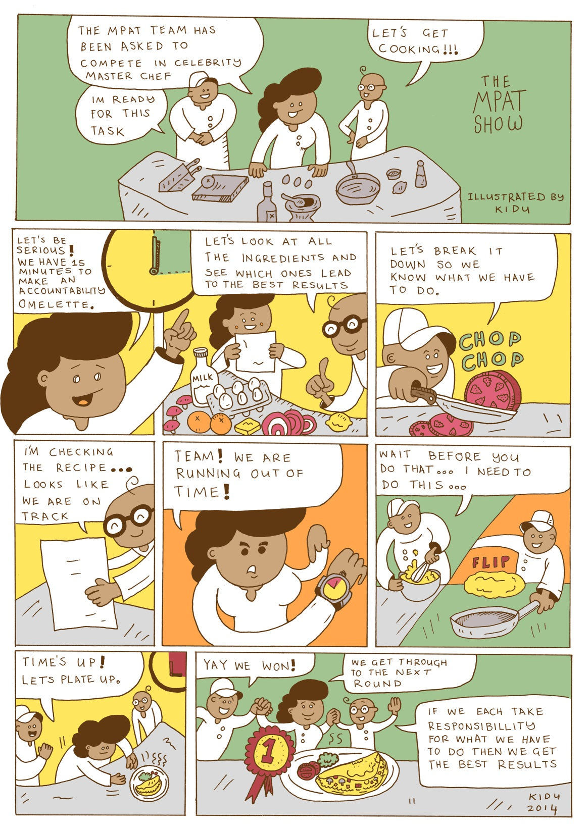
Lessons
Governance and Accountability
Salim Latib

Slide 24



G&A - should we be worried?
Yes! Societies that have succeeded do so on the basis of good governance – reflected in rule of law, accountability and capability to deliver.

Slide 25
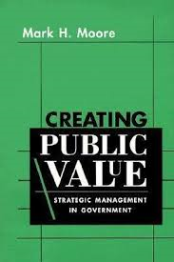

Isn't it just a societal issue?
No! Good governance finds real practical meaning at the level of institutions and in the performance of individuals.

Slide 26
So are there global trends?
Yes! Governance lapses in the private sector?
Yes! Financial lapses – spend and spend some more?
Yes! We get the people we deserve?
Yes! Finding more engaged institutional modalities for accountability?

Slide 27
Are we behind?
In theory and practice?
AREA | KPA INDICATORS
Rule of Law and legitimacy | Assessment of accountability mechanisms Assessment of policies and systems to ensure Professional ethics Assessment of internal Audit arrangements Approved EA and HoD Delegations
Accountability and Public Value | Functionality of Management Structures Annual Reporting Fraud prevention Assessment of risk management arrangements
Delivery Capability | Service Delivery Improvement Mechanism HoD delegations for Financial Administration
So Fukuyama and Moore might well be happy at theory! But practice? And substance?

Slide 28
Not really but?
4 areas and 12 indicators in Governance and Accountability
  Overall improvement from 40% to 60%
  Largest improvement - some big improvements and some declines
But! Still some areas of concern!
  Department has an approved service delivery charter, standards and service delivery improvement plans and adheres to these to improve services. (SDIP)
  Departments have measures and the requisite capacity in place to prevent and combat corruption (FRAUD PREVENTION)
  Departments have basic risk management elements in place and these function well (RISK – MANAGEMENT)

Slide 29
Policy and planning lessons
Mainstreaming Governance and Accountability into Operational Actions
Governance Compliance establishes the foundations for substantive dialogue
Separating the strategic from the operational
Governance is expensive and internal cooperation allows for efficient implementation
Initially we spend a lot of time on building awareness of the function. We had to do some road shows on matters of risk and fraud. People eventually recognised that this was about their work. It helped them do their work better and hence established buy-in needed.
Official: Department of Mineral Resources
In our Department we don’t have a dedicated unit for fraud and corruption, we have a number of units dealing with it…different sections deal with different issues…ethics is largely dealt with by people in Human Resources…they also do workshops on the Code of Conduct.
Official: North West Department of Agriculture and Rural Development

Slide 30
Capacity and involvement
  Moving beyond the generic
  Building interest and engagements through substantive reflection
  Appropriate frameworks, coupled with experience are essential for effective implementation
  Creating a culture of learning and change
We were clear that this process will take time and that people will learn as the process will unfold…let them go to the pain of learn as we move along…
Official: Eastern Cape Department of Agriculture and Agrarian Reform
Experience matters in my work…you have to know what information is needed and how to go about the investigation…we also need know the system and the procedures so that cases are not dismissed because you don’t follow the correct procedure.
Official: North West Department of Agriculture and Rural Development

Slide 31
The role of leadership
The DG is accessible on investigations. This is a sensitive area and sometimes we have to engage the DG directly and keep the Office informed of progress on particular cases. The relationship and support received allows for investigations to unfold without any difficulty.
Official: Department of Mineral Resources
  Prevention through consistent actions and success
  Standards are crucial to productivity improvements
  Building a compliance culture requires securing demonstrable senior level support
  Having a champion who engages passionately matters
We have a DG currently who is numerical…this is useful as it gets us to focus on the numbers and evidence…we can do things differently…we were fortunate to have Ministers who were drivers of change…the current Ministers is committed to modernisation and understands that this requires resources. They establish huge standards for us.
Official: Department of Home Affairs
We now have an established practice for monitoring progress on actions to be taken to mitigate risks. We receive reports from Champions and collate these for submission. We also engage directly with relevant senior managers on risk areas and progress on actions for which they are responsible for. It’s a live function as we constantly face new risks in our operations.
Official: Department of Mineral Resources

Slide 32
Organisation and resourcing
In our investigations, we make sure we pay attention to details and therefore collect all documentations and evidence in a proper manner so that we don’t face difficulties when we disciplinary steps are taken…we have been very successful in all our investigations because of this.
Official: Department of Mineral Resources
  Attention to details and proper procedure.
  Securing dedicated capacity for engagements.
  Workflow analysis is crucial to improvements
The function is distributed. All units involved are listed in the strategy document. We rely on this for doing actual implementation. But we are looking at bringing it all together so that we have dedicated capacity….this is important, we need to establish a dedicated unit so that things are taken forward.
Official: North West Department of Agriculture and Rural Development
During the early times, we recognised the importance of bringing in operational management skills…we saw the need for modernisation…we introduced an online verification system and the tracking system…we rolled out the project, consultants only assisted.
Official: Department of Home Affairs

Slide 33
Key drivers of improvement
We looked at all of the areas and challenges that arose from previous MPAT and established an approach to ensure that we deal with each of the areas systematically…we had to understand the requirements and ensure that we respond appropriately”.
Official. Eastern Cape Department of Rural Development and Agrarian Reforms
COMPLIANCE MATTERS
COMPLIANCE AND GOVERNANCE
GOVERNANCE MATTERS
DEDICATED CAPACITY
We had major challenges with internal control systems…the Auditor General report had many issues and there were cases of conflict of interest in the Department and the leadership recognised that capacity was needed for governance in the Department.
Official: North West Department of Agriculture and Rural Development

Slide 34
Overall conclusion
Targeted and incremental approach to change
COMPLIANCE ONLY FIRST STEP IN THE PROCESS
Appreciating that real change and impact takes time
So Fukuyama and Moore might well be happy at theory, practice and substance.
(NO!)
So that we would be happy with delivery, there is political capital and people experience the difference
(YES !)
Why?

Slide 35
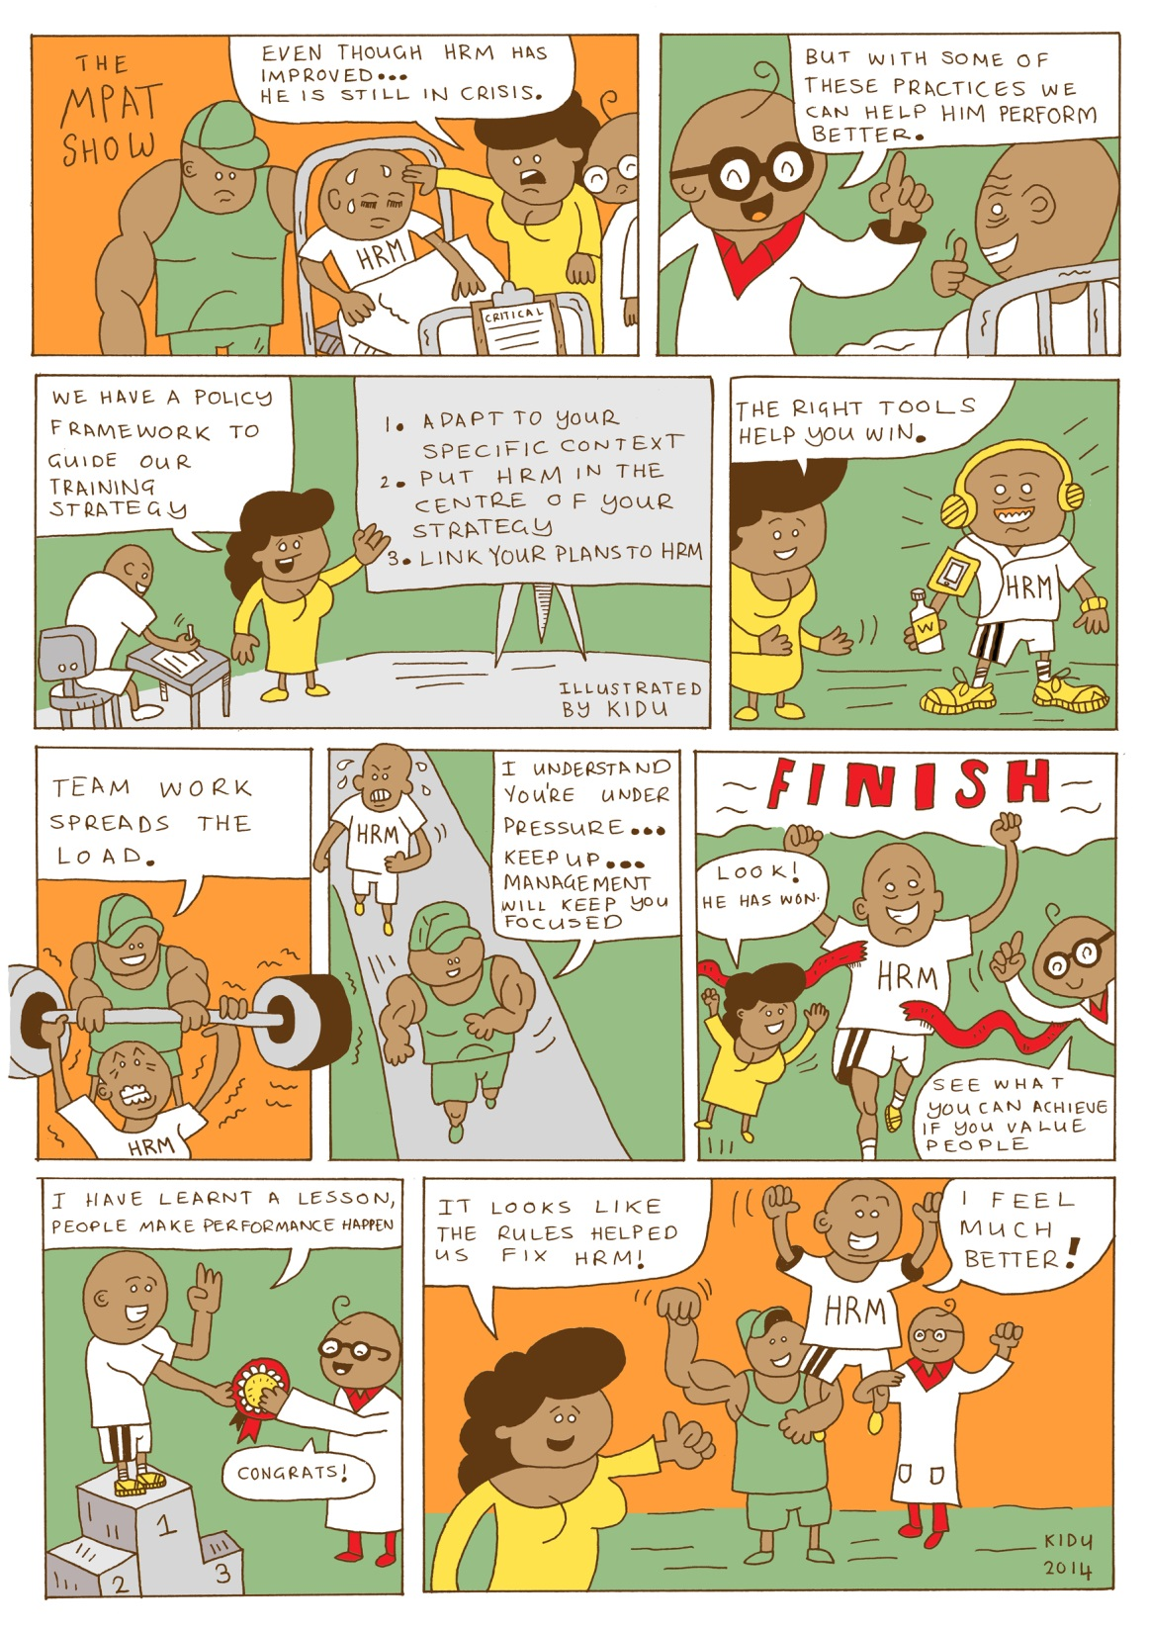
Lessons
Human Resources Management
Dinesh Budhram

Slide 36
Global practice
High performers are seeking new job opportunities elsewhere
Organisations need to compete to attract and retain them
Employee rewards will be an important factor in retention
Hiring quality is important to be addressed. Onboarding processes helping to identify poor-quality hires early on and getting high-quality hires to perform more quickly
Tapping diverse talent pools is easing strain that turnover presents (challenges exist! Case of USA technology industry – Microsoft, Apple, Google!)
Talent management, leadership, workforce planning and workforce intelligence receiving larger piece of HR budgets
Source: State of the Workforce – Results from PWC Saratoga’s 2013/14 US Human Capital Effectiveness Report

Slide 37
Assessment of HR standards
65% of departments (74% in 2012) were assessed as non-compliant with the standard related to organisational design.
82% of department (88% in 2012) were assessed as non-compliant for the standard related to human resource planning.
Only two departments achieve level 3 and above for the standard on diversity management.
90% of departments (88% in 2012) were assessed as non-compliant for the standard related to management of disciplinary cases.
Statistical analysis indicates that the standards in human resource management directly influence a department’s achievement of annual targets.
HR saw a 39% overall compliance (score of 3 or 4)

Slide 38
Key drivers of improvement
Right people using the right tools drive results
“It gives me a bird’s eye view of the situation. Each week before our HR meeting I paint any entries that are behind schedule in red and I put people under the spotlight ... At the next meeting, there is always a big improvement. It creates a consciousness and responsibility to deliver properly.” GCIS
Engagement and consulting early in process
“Need to engage internal and external stakeholders from the start “ Dept of Energy
Factual evidence and data drives decisions
“Base planning and decisions on facts” NC Dept of Social Dev
Policy guidelines are a catalyst for compliance

Slide 39
Policy and planning
A comprehensive national policy framework drives compliance
National policy provides the foundation for contextual adaptation
Has HR arrived on the strategic agenda?
HR should be on the strategic agenda - KZN Dept of ED&T
“Now there is an understanding that to plan operations, you need HR to provide the most important resource: your people.” Northern Cape DRPW

Slide 40
Processes and resources
Tools are essential in meeting organisational targets
Streamlining speeds up delivery
Lack of resources is not necessarily a constraint
“Resources were spread thin, but this was also an opportunity..Usually this would lead to a dilution of efforts but in this case it also afforded the OD team a wider perspective, which facilitated integration.” Northern Cape DSD

Slide 41
Leadership and consistency of purpose
A high performance culture requires ‘top down’ engagement
Team spirit at the heart of HR units’ successes
Understanding what drives us
“Last year, the CEO said that in every employee’s Performance Agreement there has to be a pledge that says ‘I will meet all deadlines’. We started with SMS members, now everyone has it. When we assess people, we hold them accountable.”

Slide 42
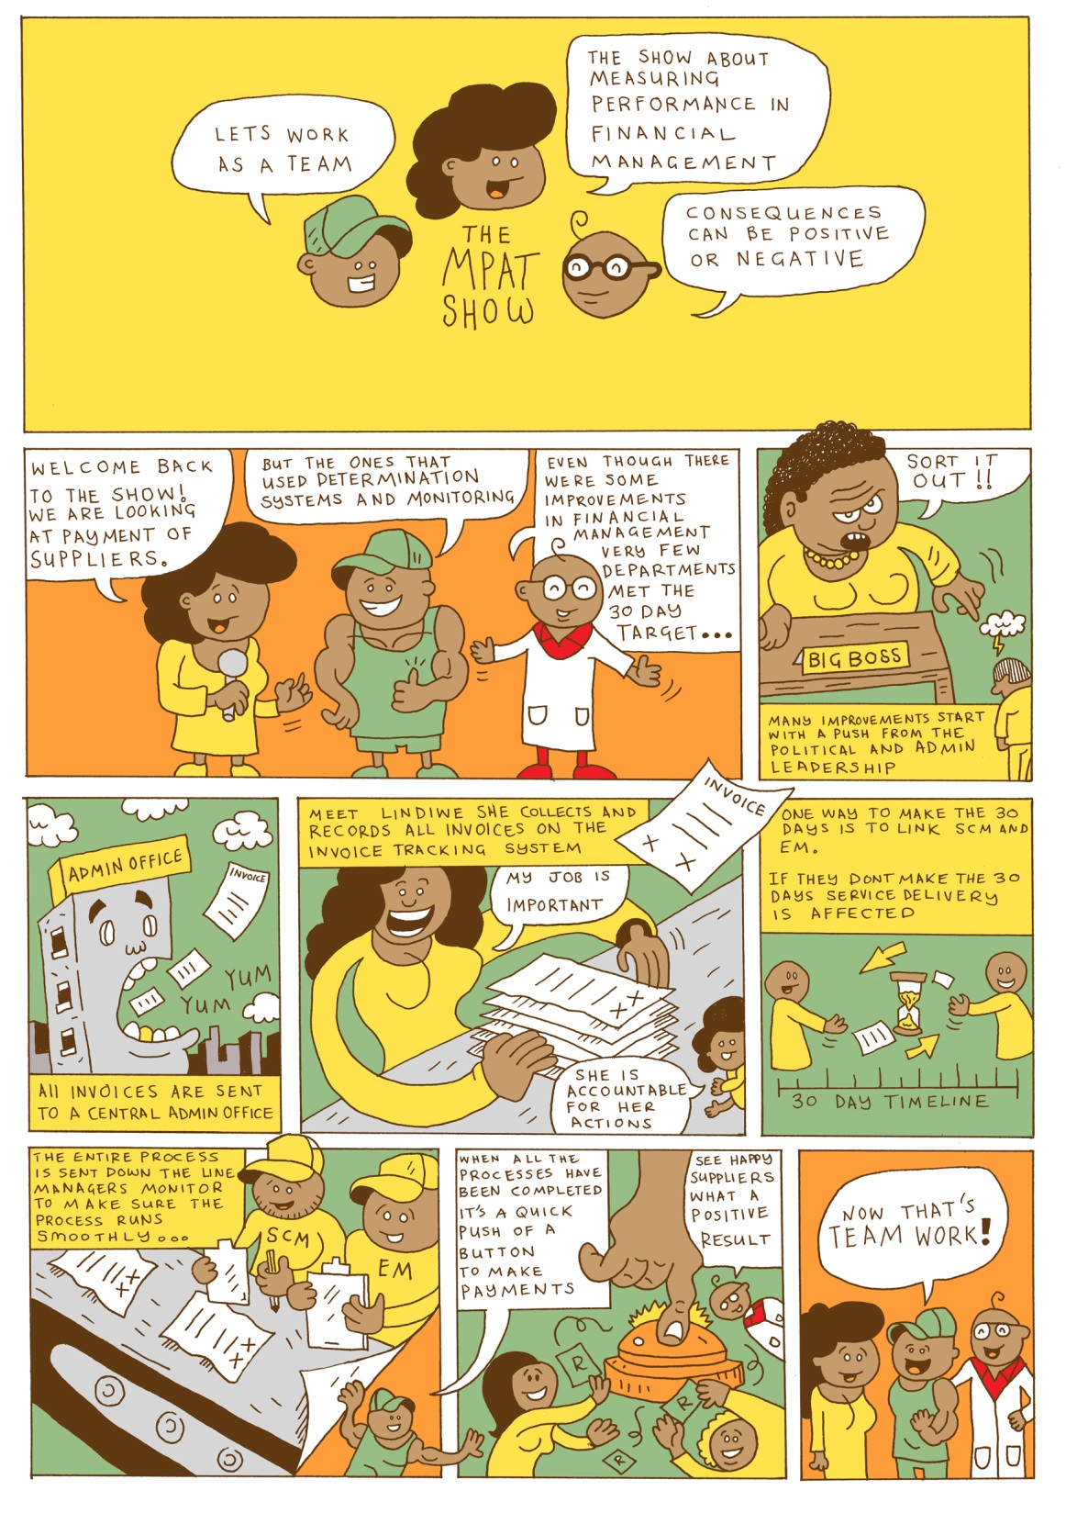
Lessons
Financial Management
Myo Naing

Slide 43
Overview
Deals with all aspects of resource mobilisation and expenditure management in government departments
The Public Finance Management Act (PFMA) promotes good financial management through the effective and efficient use of limited resources.
KPA covers Supply Chain Management (SCM) and Expenditure Management (EM) practices and complements the monitoring done by National Treasury. SCM standards include demand, acquisition, logistics and disposal management. EM includes cash flow management, payment of suppliers and unauthorised, irregular, fruitless and wasteful expenditure.

Slide 44
Global practice (challenges)
Late payment to suppliers can be traced back many centuries:
  US: in a year, the unpaid payments totals more than $2.4 trillion
  Malawi: Currently the Ministry of Finance (MoF) has acknowledged that GoM has to pay suppliers and contractors close to MWK 370 billion in arrears
But:
  UK central government bodies now pay more than 90% of invoices within 5 days Ireland reduced payment periods to 15 days for Government Departments (Finfacts, 2009), which made 96% of total payments within 15 days (DJEI, 2014).
SA: The Department of Social Development of Northern Cape pay suppliers within 5 days.

Slide 45

The dogs ate the invoice
The dogs ate the invoices

Slide 46
The theory
They want to be paid as early as possible. And they should be paid on time.
Suppliers
(SMEs)
Customers
(Departments)
They do not want to pay early (power position - financial strategy of having free credit).
Other
Initiatives
(MPAT)
“Naming & shaming” Companies who pay late are put in ‘Hall of Shame’ (Card, 2014). Payment Practices Barometer,
Supply Change Finance
Legislation
(Government)
Positive externalities of early or in time payment to suppliers, e.g., small business development, in turn, job creation.

Slide 47
Progress to date
Compliance of 56% is cause for concern in a country beset with development challenges. Departments perform better in supply chain management with almost 65% at level 3 and 4.
On Payment of Suppliers, notwithstanding the FOSAD monitored and long-proclaimed intention for government to pay in thirty days 87% of departments score 1s and 2s.
In terms of change patterns, FM is relatively stable with a small improvement in acquisition management and a decline in the score for the standard on payment of suppliers.
The picture across sectors is equally static with the Finance sector showing a slight decline. Both OtPs and Provincial Treasuries play a central role in leading and coordinating financial management compliance. Provincial Treasuries need to be strengthened to support FM improvements. This requires improved intergovernmental relationships with OtPs and provincial treasuries.

Slide 48
Key drivers of improvement
Leadership commitment
Managerial vigilance and involvement throughout the process.
Right systems (registering process, securing information, data-base, setting internal due-dates, office-layout)
Right people, right culture, attitude, team-work

Slide 49
Key drivers of improvement
Hardware
Materials: Building, machines, BMW
MPAT
Software
Programme: Systems, legislation, policies, compliance, leadership quality,
management practices, organisational culture (or social capital)
Operators
People: who lead, manage, implement -
leadership, managers, staff, role-players
Human side
Hardware: Physical, body
Software: Psychological, mental, will,
attitude, determination, commitment

Slide 50
Lessons
Leader’s commitment, dedication and support
Clear, well-communicated vision and targets
Right system, right people in the right place, information
Managerial vigilance and involvement throughout the process, holding accountability through monitoring and controlling
Organisational culture and arrangement (or office layout or Feng shui)
Peer pressure or accountability

Slide 51
Should we be worried?
YES! Because the number of departments that achieved Level 3 and Level 4 have dropped.
 | 2011 | 2012 | 2013
Level 4 (full compliance while “doing things smartly”) | No study on payment of suppliers | 7% | 5%
Level 3 (full compliance) |  | 49% | 7%
Level 2 (partial compliance) |  | 20% | 68%
Level 1 (non-compliance with legal/regulatory standards) |  | 24% | 19%

Slide 52
Discussion and suggestions
Compliance does create an awareness of performance, and in turn improves performance and productivity, but the process behind compliance and performance has to be logical and right.
Need to set the cost of breaking the rule, i.e. zero tolerance approach.
Leadership or management have a different threshold to non-compliance and the level of will or commitment affects this commitment.
Replicating the surface will not work, addressing the depth is must.

